Slide 1
Understanding America's Childcare Markets
An Unsupervised Machine Learning Approach to County-Level Childcare Pricing
BA820 | Section A1 | Team 4
Kai Tran • Akhil Nair • Shon Shaju • Hemanth Kumar Gopi

Slide 2
01
Introduction & Data Overview

Slide 3

Introduction
"In some counties, families spend more on childcare than on housing. Yet we treat all counties the same." — Motivated by: U.S. Dept. of Labor Women's Bureau, 2023 Issue Brief
Why this research matters
Cost Crisis
Mothers leaving workforce
Only 16% Get Help
Childcare costs range from 8% to over 20% of family income depending on county
Mothers in high-cost counties are quietly exiting the workforce. Not by choice, but because the math no longer works
Despite federal subsidies, only 16% of eligible families receive childcare assistance. States ration limited funds, and many parents don't know they qualify.
-U.S. Department of Labor Women's Bureau 2023
-U.S. Department of Labor Women's Bureau 2023
- the Federal Register (2023)
Stakeholder:
Parents
Employers
Policymakers
1 in 4 mothers reduces work hours due to childcare costs (Census, 2025)
High childcare burden reduces local workforce participation rates
State averages underestimate urban costs by up to 40% (DoL, 2023)

Slide 4




Data Overview
3,144
U.S Counties
11 Years
(2008 - 2018)
~34k
rows
Features
Merge Datasets
Category | Variables
Childcare Costs (6) | Center & family-based × infant, toddler, preschool (weekly $)
Income | Median household income (2018$)
Labor Market (2) | Female labor participation, unemployment rate (ages 20–64)
Poverty | Poverty rate for individuals
Engineered (4+) | Affordability ratio, infant–preschool gap, center–family gap, provider type ratio
1
Adds county name & state identifiers for interpretability
Outlier Flagging
2
Flag top 5% extreme counties
Median Imputation
3
7–8% of price columns missing

Slide 5
02
Pipeline Overview
You can enter a subtitle here if you need it

Slide 6
If childcare markets aren't the same, what’s different?
1
Do counties form distinct childcare market types?
2
How do market types differ in affordability and maternal labor force participation?
3
Do pricing structures align more with socioeconomic similarity than geographic proximity?
4
Which counties are structurally extreme and what distinguishes them?

Slide 7

Turning County-Level Data into Market Segments
Raw Data
Preprocess
PCA
UMAP
Cluster Profiling
34K county-year
observations
Aggregate, impute, log transform, scale
“One big gradient”
(M2/M3)
Non-linear: 6 types found (M4)
Real $ values,
policy narratives
Key Evolution: PCA (linear) saw a single affordability gradient; UMAP (non-linear) saw six different market types.
Preprocessing Steps:
County-level averaging (3,144 counties) → Median imputation (~8% missing) → Log₁₊ transform on 10 skewed features → StandardScaler
Log transform was the key M4 fix: UMAP builds a neighborhood graph sensitive to density. Right-skewed costs distorted neighborhoods without it.

Slide 8
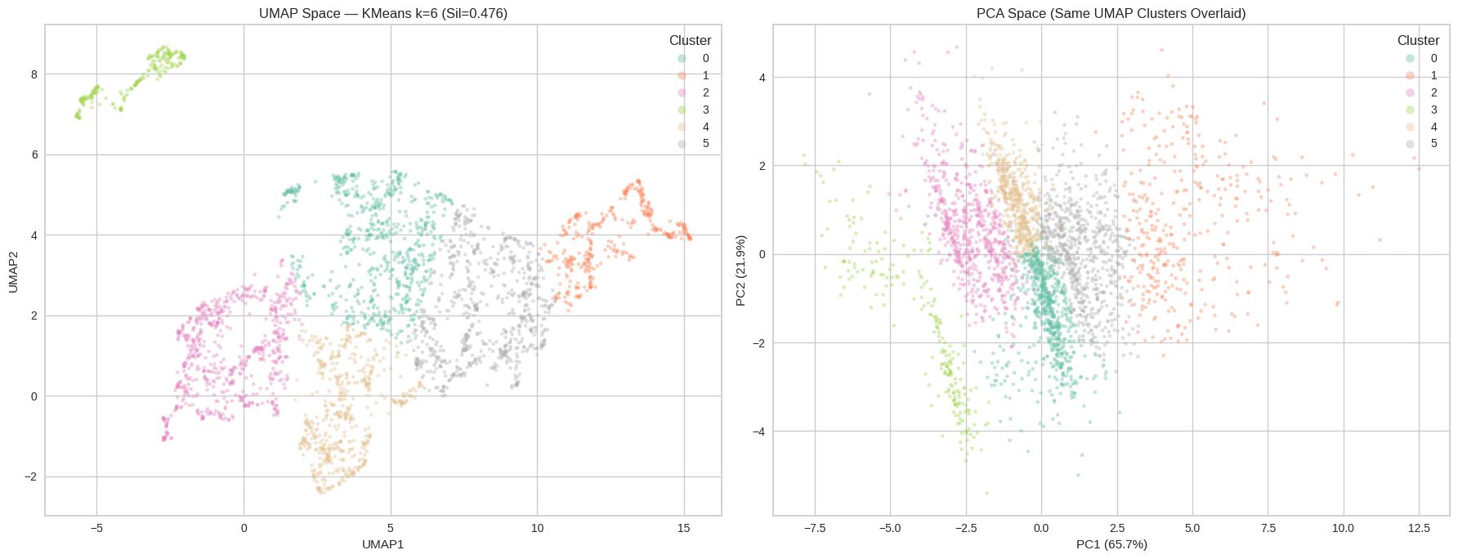
Q1: Do Counties Form Distinct Market Types?
What Was Explored:
M3 vs M4
PCA + KMeans + Hierarchical (M2/M3): k=2 just isolated outliers. After removing top 5%, k=5 worked but silhouette only 0.24.
UMAP + KMeans (M4): 4×4 parameter grid tested. Best config: n_neighbors=15, min_dist=0.1. k=6 with silhouette 0.48 — nearly double M3.
Stability: 10 random seeds → silhouette std = 0.003. Structure is real.
 | M3 (PCA) | M4 (UMAP)
Clusters | 5 | 6
Balance ratio | 0.351 | 0.324
Silhouette | 0.247 | 0.467
Takeaway: Counties do form distinct types, but only visible through non-linear analysis. PCA saw one gradient; UMAP identified 6 groups.

Slide 9
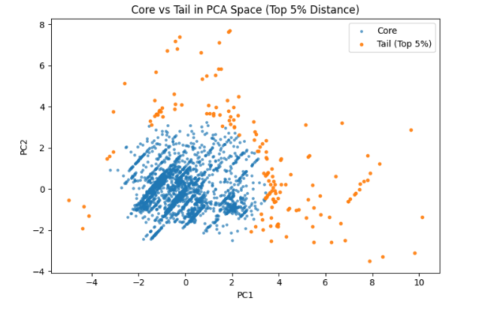
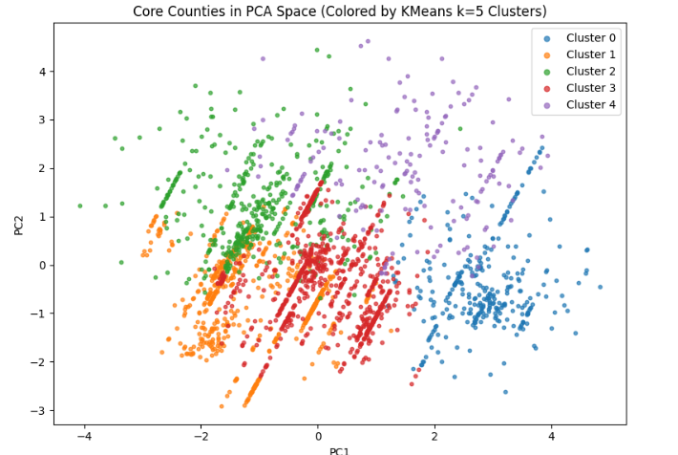
Q2: How do market types differ in affordability and maternal labor force participation?
From M3 we learned that:
Outlier counties distorted all clusters
No affordability context price only
For M4:
Added infant/preschool ratio + center-family gap as structure features
PCA to isolate top 5% extreme tail → re-cluster on core
Takeaway: Despite distinct cost clusters, mothers' workforce participation overlaps across all groups. Show the boxplot with overlapping distributions.

Slide 10
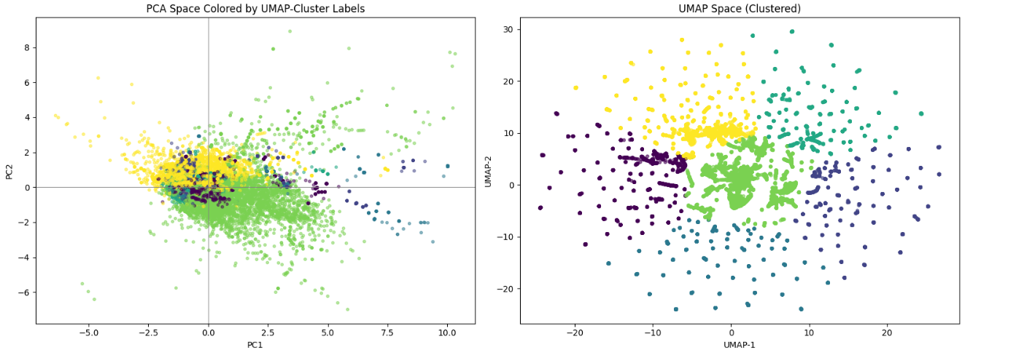
Q3: Do pricing structures align more with socioeconomic similarity than geographic proximity?
What Was Explored:
From M3 we learned that:
10 raw features: center + family costs + socioeconomics
PCA captured 87% variance in just 2 components
For M4:
PCA sees one gradient clusters heavily overlap along PC1, no clean separation
UMAP reveals 6 groups with clearer boundaries, especially at the periphery
Dense center confirms a continuum clusters connect through a shared middle rather than sitting as isolated islands
k=6 chosen silhouette peaks at 6 before tapering, confirmed by the visual separation in UMAP space
Takeaway: Socioeconomic similarity explains pricing differences better than geographic proximity. Counties across various states can have identical childcare markets if their income/poverty profiles match.

Slide 11
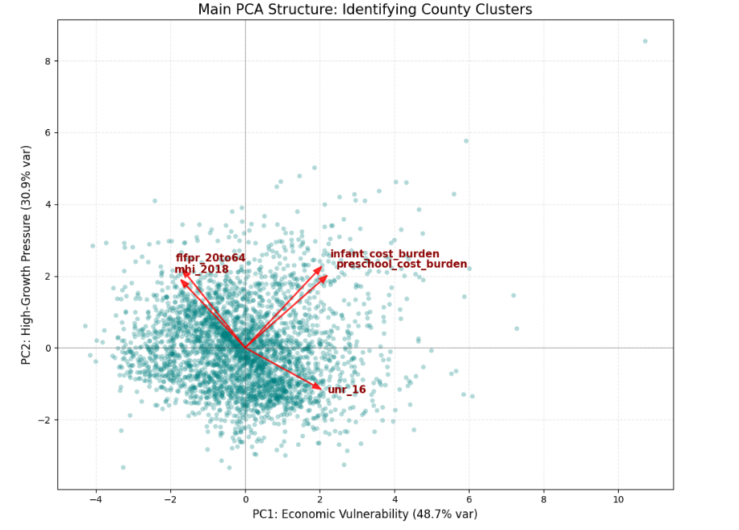
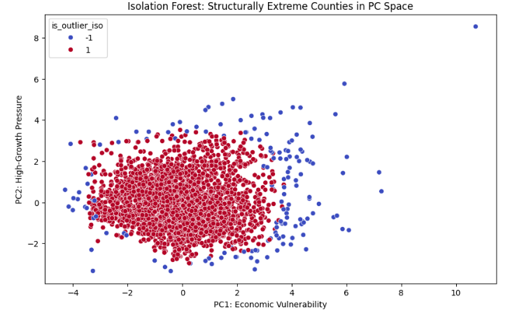
Q4: Which counties are structurally extreme and what distinguishes them?
What Was Explored:
From M3 we learned that:
Raw cost + socioeconomic variables clustered into k=5 after removing top 5% outliers via PCA distance
No income-relative affordability measure — price only, no burden context
High-cost counties distorted cluster structure
For M4:
PCA biplot reveals two distinct crises: PC1 (48.7% var) = economic vulnerability, PC2 (30.9% var) = high-growth urban pressure
Isolation Forest replaced manual PCA-distance cuts to flag the true structural outliers (5% contamination)
DBSCAN added alongside KMeans to detect non-spherical noise naturally
Extreme counties scatter across both axes — not concentrated in one crisis type
Takeaway: Counties that have higher income have lower unemployment rates, however they naturally have higher cost burden

Slide 12
The Integrated Picture
6 Market Types: Markets aren't random; they fall into 6 clear "personalities" defined by complex cost-to-income ratios
Economic DNA: Markets are driven by the DNA of local economics (income, poverty, unemployment), making state-line geography secondary.
Wealthy Outliers: The "Crisis" looks different in affluent cities; high wealth creates a massive supply bottleneck and price spikes, proving this isn't just a poverty issue.
Buffer Effects: Working mothers' labor choices are influenced by cultural and family support factors, not just the raw price tag of childcare.

Slide 13
04
Limitations

Slide 14
Limitations
Pre-Pandemic Data Window:
Our study covers 2008–2018, meaning recent extreme inflationary shifts and post-COVID labor changes aren't captured.
Cluster "Softness":
Interpretability vs. Accuracy:
While the 6 market patterns are clear, the exact boundaries between these market types are fluid, not hard lines.
High-dimensional tools like UMAP provide excellent grouping accuracy, but the visual distances lack a direct physical scale we can measure.
No Direct Causality:
Unsupervised learning shows us very strong patterns and correlations, but cannot prove direct cause-and-effect.

Slide 15
The Bottom Line (So What?)
01
For Policy Makers:
02
For Employers:
03
For Families:
Low cost does not mean affordable. Two counties with identical childcare prices can face completely different economic realities and require unique policy support.
Stop relying on national or state averages. Subsidies and interventions must be targeted to the 6 specific market regimes we identified.
Corporate location-based stipends must account for local "market personalities" and supply bottlenecks, not just standard cost-of-living.
Understanding your local market specific supply constraints can help parents make better long-term financial and career plans.

Slide 16
Thanks!

Slide 17
Resources
Landivar, L.C., Graf, N.L., & Altamirano Rayo, G. (2023). Childcare Prices in Local Areas: Initial Findings from the National Database of Childcare Prices. U.S. Department of Labor, Women's Bureau. https://www.dol.gov/sites/dolgov/files/WB/NDCP/508_WB_IssueBrief-NDCP-20230213.pdf
Araujo, V., McBride, L., & Sandler, D.H. (2025). The Impact of Childcare Costs on Mothers' Labor Force Participation. U.S. Census Bureau, Center for Economic Studies Working Paper No. CES-WP-25-25. https://www.census.gov/library/working-papers/2025/adrm/CES-WP-25-25.html
U.S. Government Accountability Office. (2023). Child Care: Subsidy Eligibility and Use in Fiscal Year 2019 and State Program Changes During the Pandemic. GAO-23-106073. https://www.gao.gov/products/gao-23-106073

Slide 18
Appendix

Slide 19
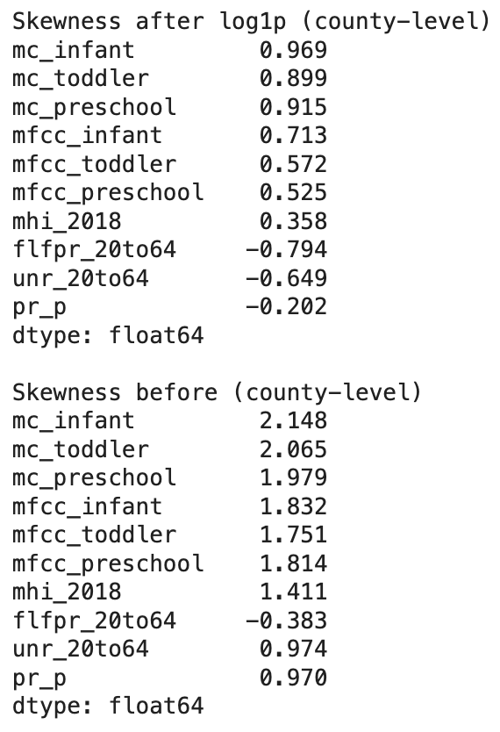
Skewness for 10 Features

Slide 20
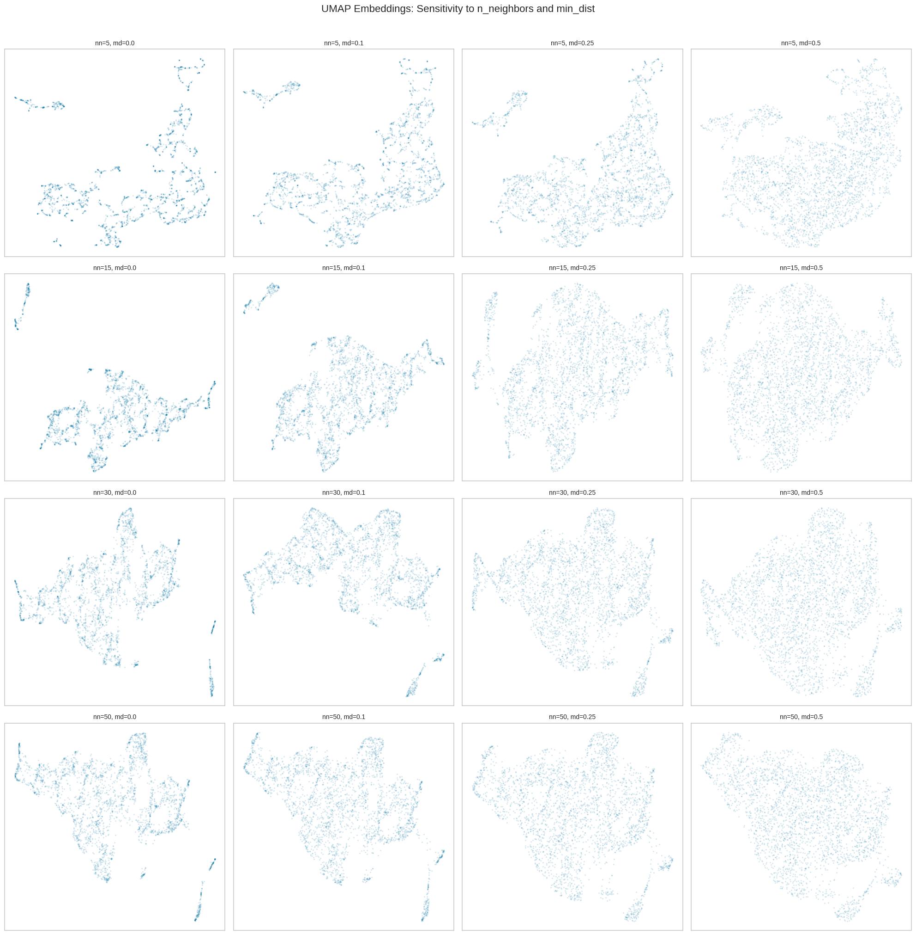
UMAP Parameter Grid

Slide 21
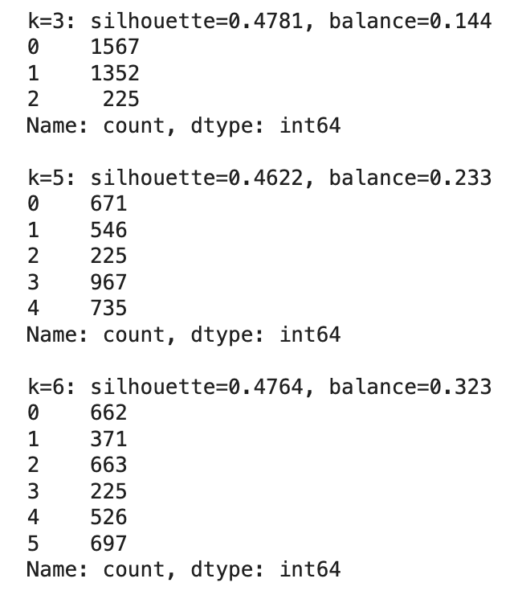
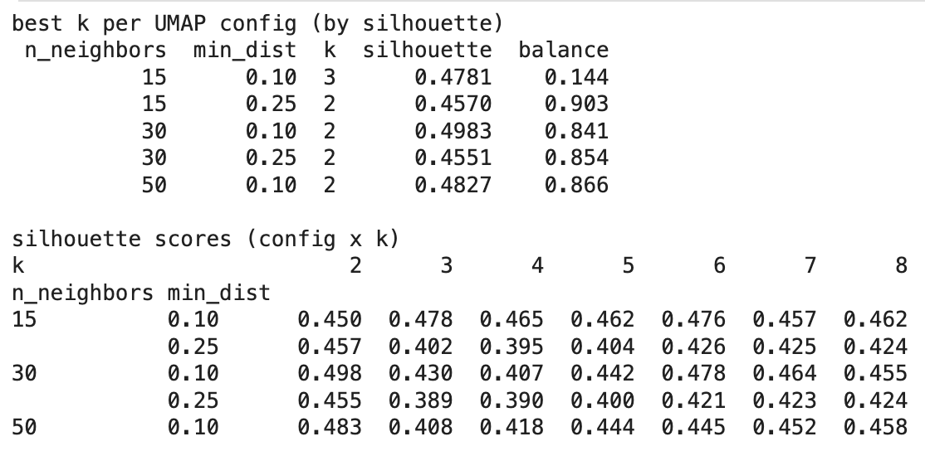
Finding best nn, min_d, k

Slide 22
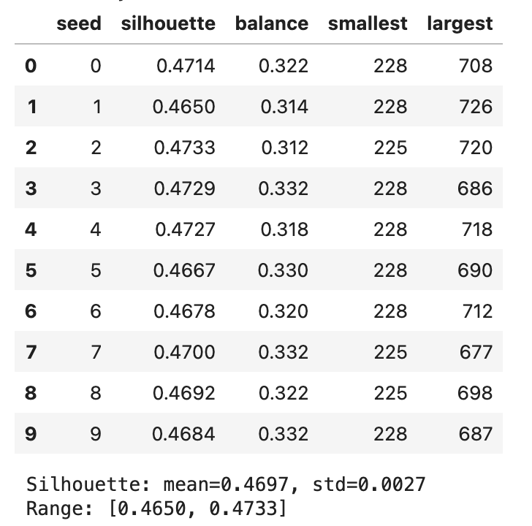
Stability Across Seed

Slide 23
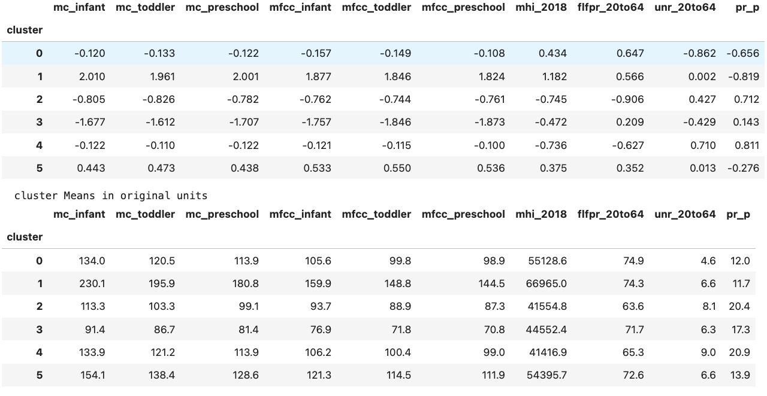
Cluster Profiles (Original Units)

Slide 24
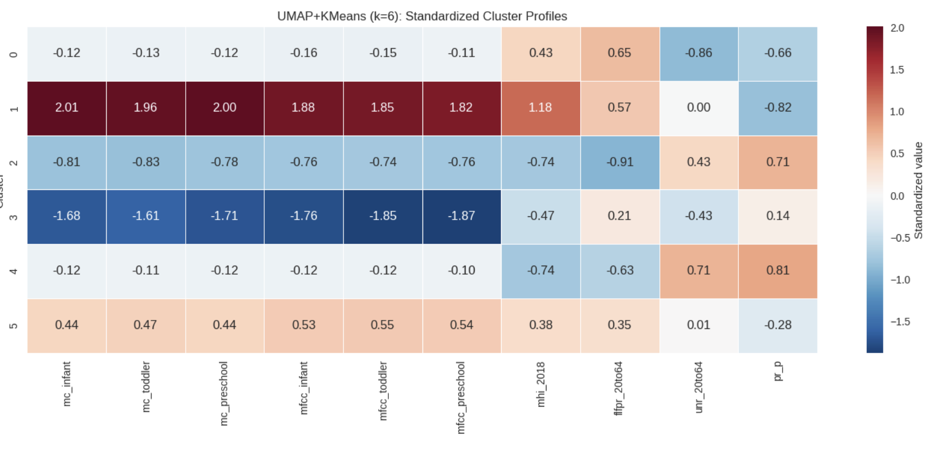
Cluster Profiles (Heatmap)

